Slide 1
Superstore Analysis Project 3
By: Jason Patterson

Slide 2
Qualifying Questions
What is Superstore’s worst performing product category/item?
What is the financial impact on Superstore’s overall profits?
Should Superstore relinquish selling those products?

Slide 3
Hypothesis
The hypothesis of this analysis aims to predict that Furniture is the least profitable amongst all of Superstores’ 3 categories. This performance is largely attributed to the low throughput of certain product items within the category, and the discount pricing strategy set in place by the Superstore management team.

Slide 4
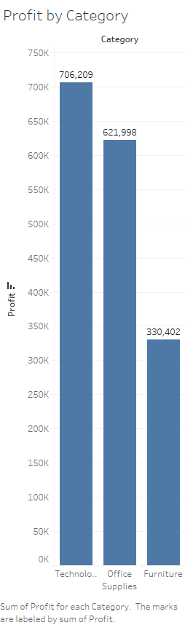
High Level Analysis
Technology generates the highest profits for Superstore
Furniture generates the lowest

Slide 5
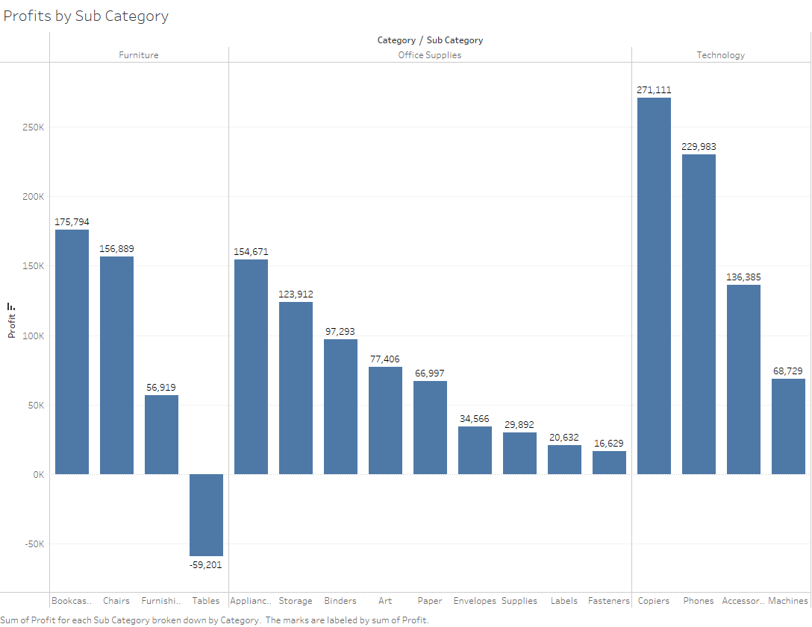
Deep Dive into the Sub Categories

Slide 6
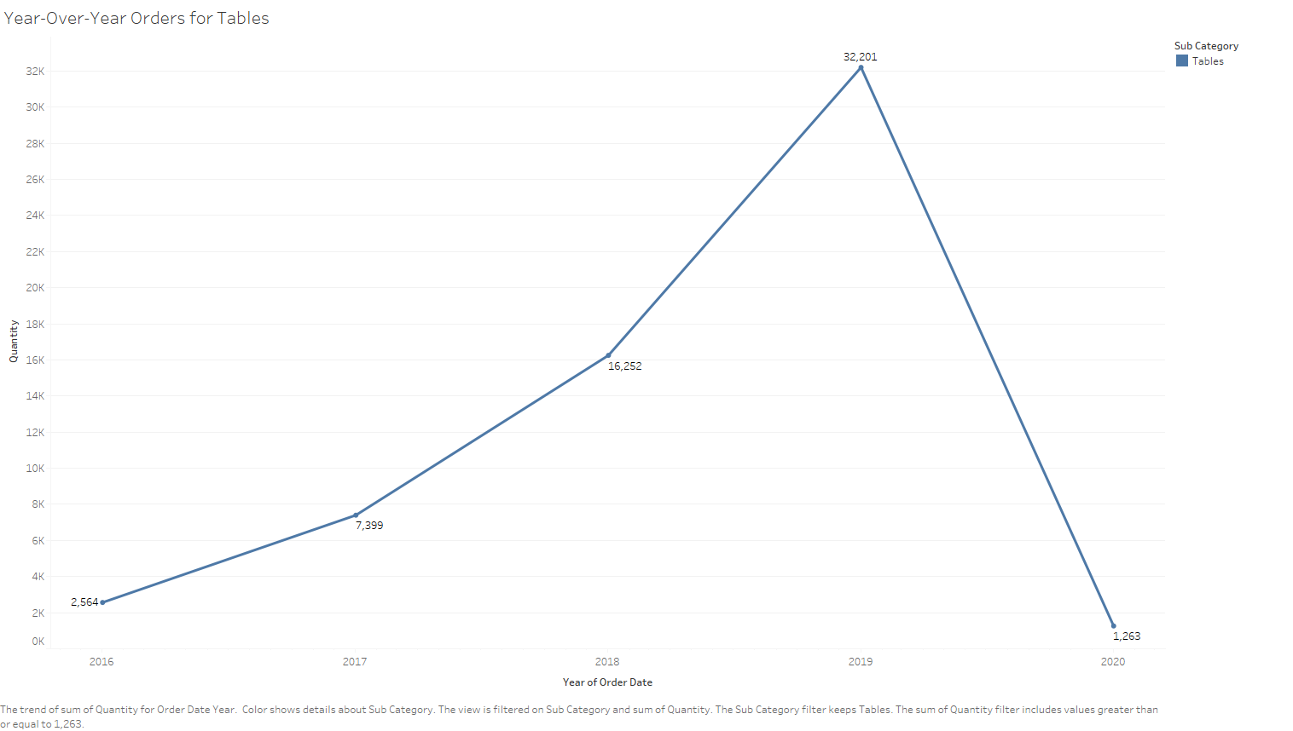
Table Orders through the Years

Slide 7
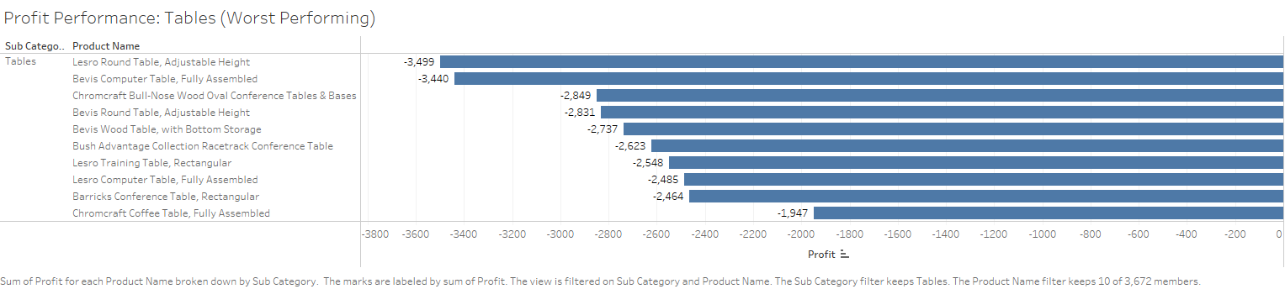
Best of the Worst

Slide 8
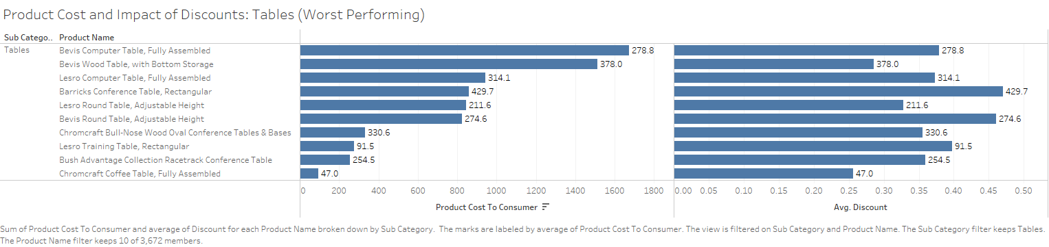
Discounts in relation to Selling Price (Tables)

Slide 9
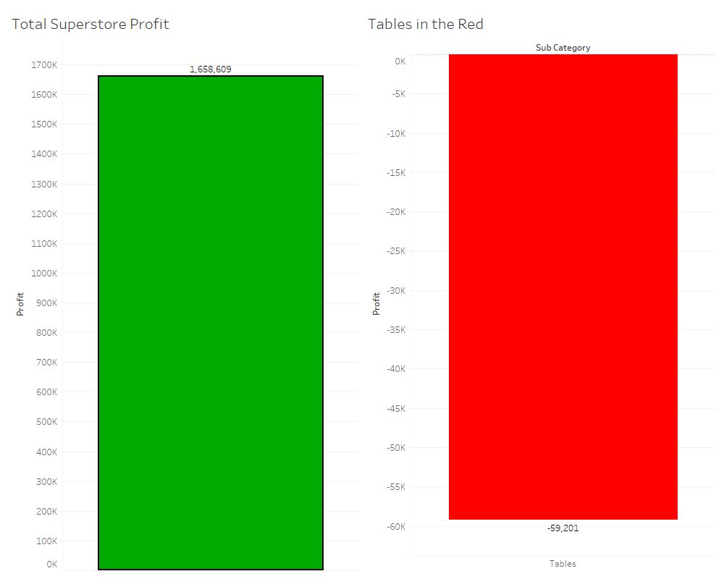
Impact of Tables’ performance in relation to total Profits
Total profits for Superstore: $1,658,609
Total profits generated by Tables sub-category: -$59,201
Overall impact on profits: 4%

Slide 10
Recommendations
The overall impact of Tables’ performance is not impinging on Superstore’s profit potential on a large scale. But at the end of the day, you get into business to make money, not to lose money. Therefore, it would be to Superstores’ advantage to re-evaluate what they should have in inventory versus what they shouldn’t in relation to this sub-category.
Benchmark what other competitors are doing in relation to this category to stay competitive
Adopt their best practices, as it could potentially improve performance.
Do not remove the sub-category entirely. Maintain product diversity.

